Slide 1
Deep Learning in Image analysis Lecture 5
Takashi Sato & Tom Jhou

Slide 2
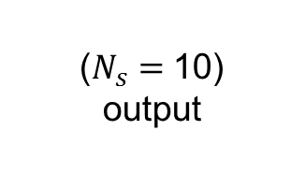











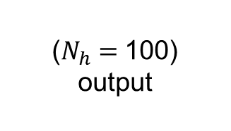
Deep Network
$h=W_{1}x+ b_{1}$
(100,1)
(100,784)
(784,1)
(100,1)
Input
Output
784x1
10x1
$$x$$
$$h$$
$$s$$
$$W_{1}$$
$$W_{2}$$
$$x_{1}$$
$$x_{2}$$
28 (H)
$$x_{3}$$
...
......
...
28 (W)
$$x_{784}$$
($N_{x}=$784)
input
($N_{h}=$100)
output
($N_{s}=$10)
output

Slide 3


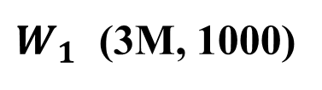
Deep Network
$h=W_{1}x+ b_{1}$
$a= max(0, h)$
$s=W_{2}a+ b_{2}$
Input
Output
784x1
(10,1)
(10,100)
(100,1)
(10,1)
10x1
$$x$$
$$h$$
$$s$$
$$W_{1}$$
$$W_{2}$$
$$x_{1}$$
$$x_{2}$$
28 (H)
$$x_{3}$$
...
......
...
28 (W)
$$x_{784}$$
($N_{x}=$784)
input
($N_{h}=$100)
output
($N_{s}=$10)
output
$W_{1}$ (3M, 1000)
1024 x 1024 x 3
1000

Slide 4
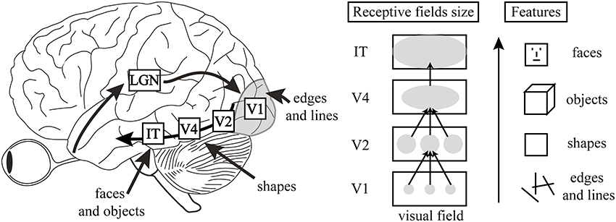
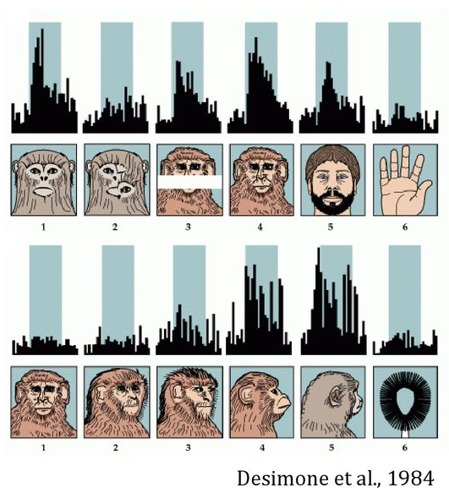
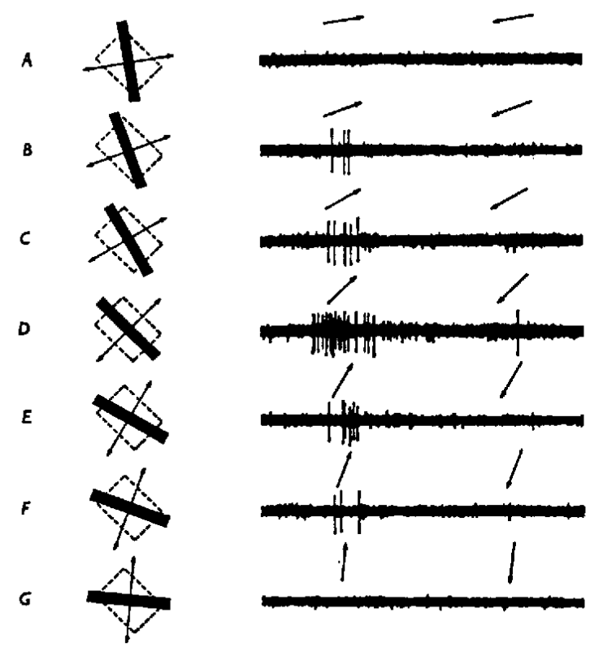
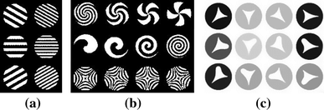
Visual processing in the brain
Herzog and Clarke (2014)
V1
V4
IT

Slide 5
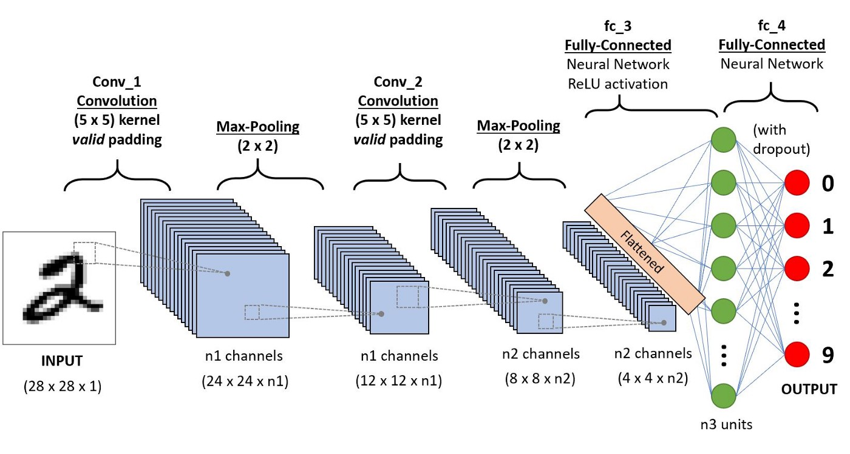
Visual processing in the brain
Herzog and Clarke (2014)

Slide 6

Vertical edge detection
5 | 0 | 3 | 3 | 7 | 9 | 3 | 5 | 2
7 | 6 | 8 | 8 | 1 | 6 | 7 | 7 | 8
5 | 9 | 8 | 9 | 4 | 3 | 0 | 3 | 5
2 | 3 | 8 | 1 | 3 | 3 | 3 | 7 | 0
9 | 9 | 0 | 4 | 7 | 3 | 2 | 7 | 2
0 | 4 | 5 | 5 | 6 | 8 | 4 | 1 | 4
8 | 1 | 1 | 7 | 9 | 9 | 3 | 6 | 7
0 | 3 | 5 | 9 | 4 | 4 | 6 | 4 | 4
4 | 4 | 8 | 4 | 3 | 7 | 5 | 5 | 0
-1 | 0 | 1
-1 | 0 | 1
-1 | 0 | 1
$$∗$$
3 x 3
9 x 9

Slide 7

Vertical edge detection
5 | 0 | 3 | 3 | 7 | 9 | 3 | 5 | 2
7 | 6 | 8 | 8 | 1 | 6 | 7 | 7 | 8
5 | 9 | 8 | 9 | 4 | 3 | 0 | 3 | 5
2 | 3 | 8 | 1 | 3 | 3 | 3 | 7 | 0
9 | 9 | 0 | 4 | 7 | 3 | 2 | 7 | 2
0 | 4 | 5 | 5 | 6 | 8 | 4 | 1 | 4
8 | 1 | 1 | 7 | 9 | 9 | 3 | 6 | 7
0 | 3 | 5 | 9 | 4 | 4 | 6 | 4 | 4
4 | 4 | 8 | 4 | 3 | 7 | 5 | 5 | 0
2
5
-7
-2
-2
-3
5
10
0
-1 | 0 | 1
-1 | 0 | 1
-1 | 0 | 1
$$∗$$
$$=$$
3 x 3
9 x 9
7 x 7

Slide 8
Vertical edge detection
5 | 0 | 3 | 3 | 7 | 9 | 3 | 5 | 2
7 | 6 | 8 | 8 | 1 | 6 | 7 | 7 | 8
5 | 9 | 8 | 9 | 4 | 3 | 0 | 3 | 5
2 | 3 | 8 | 1 | 3 | 3 | 3 | 7 | 0
9 | 9 | 0 | 4 | 7 | 3 | 2 | 7 | 2
0 | 4 | 5 | 5 | 6 | 8 | 4 | 1 | 4
8 | 1 | 1 | 7 | 9 | 9 | 3 | 6 | 7
0 | 3 | 5 | 9 | 4 | 4 | 6 | 4 | 4
4 | 4 | 8 | 4 | 3 | 7 | 5 | 5 | 0
2 | 5 | -7 | -2 | -2 | -3 | 5
10 | 0 | -16 | -6 | 2 | 5 | 3
0 | -7 | -2 | -5 | -9 | 8 | 2
2 | -6 | 3 | 4 | -7 | 1 | -3
-11 | 2 | 16 | 4 | -13 | -6 | 4
3 | 13 | 8 | 0 | -6 | -10 | 2
2 | 12 | 2 | 0 | -2 | -5
-1 | 0 | 1
-1 | 0 | 1
-1 | 0 | 1
$$∗$$
$$=$$
3 x 3
-3
9 x 9
7 x 7

Slide 9


Vertical edge detection
0 | 0 | 0 | 0 | 0 | 10 | 10 | 10 | 10
0 | 0 | 0 | 0 | 0 | 10 | 10 | 10 | 10
0 | 0 | 0 | 0 | 0 | 10 | 10 | 10 | 10
0 | 0 | 0 | 0 | 0 | 10 | 10 | 10 | 10
0 | 0 | 0 | 0 | 0 | 10 | 10 | 10 | 10
0 | 0 | 0 | 0 | 0 | 10 | 10 | 10 | 10
0 | 0 | 0 | 0 | 0 | 10 | 10 | 10 | 10
0 | 0 | 0 | 0 | 0 | 10 | 10 | 10 | 10
0 | 0 | 0 | 0 | 0 | 10 | 10 | 10 | 10
-1 | 0 | 1
-1 | 0 | 1
-1 | 0 | 1
$$∗$$
$$=$$
3 x 3
9 x 9

Slide 10

Vertical edge detection
0 | 0 | 0 | 0 | 0 | 10 | 10 | 10 | 10
0 | 0 | 0 | 0 | 0 | 10 | 10 | 10 | 10
0 | 0 | 0 | 0 | 0 | 10 | 10 | 10 | 10
0 | 0 | 0 | 0 | 0 | 10 | 10 | 10 | 10
0 | 0 | 0 | 0 | 0 | 10 | 10 | 10 | 10
0 | 0 | 0 | 0 | 0 | 10 | 10 | 10 | 10
0 | 0 | 0 | 0 | 0 | 10 | 10 | 10 | 10
0 | 0 | 0 | 0 | 0 | 10 | 10 | 10 | 10
0 | 0 | 0 | 0 | 0 | 10 | 10 | 10 | 10
0 | 0 | 0 | 30 | 30 | 0 | 0
0 | 0 | 0 | 30 | 30 | 0 | 0
0 | 0 | 0 | 30 | 30 | 0 | 0
0 | 0 | 0 | 30 | 30 | 0 | 0
0 | 0 | 0 | 30 | 30 | 0 | 0
0 | 0 | 0 | 30 | 30 | 0 | 0
0 | 0 | 0 | 30 | 30 | 0 | 0
-1 | 0 | 1
-1 | 0 | 1
-1 | 0 | 1
$$∗$$
$$=$$
3 x 3
9 x 9
7 x 7

Slide 11

Vertical edge detection
0 | 0 | 0 | 0 | 0 | 10 | 10 | 10 | 10
0 | 0 | 0 | 0 | 0 | 10 | 10 | 10 | 10
0 | 0 | 0 | 0 | 0 | 10 | 10 | 10 | 10
0 | 0 | 0 | 0 | 0 | 10 | 10 | 10 | 10
0 | 0 | 0 | 0 | 0 | 10 | 10 | 10 | 10
0 | 0 | 0 | 0 | 0 | 10 | 10 | 10 | 10
0 | 0 | 0 | 0 | 0 | 10 | 10 | 10 | 10
0 | 0 | 0 | 0 | 0 | 10 | 10 | 10 | 10
0 | 0 | 0 | 0 | 0 | 10 | 10 | 10 | 10
0 | 0 | 0 | 0 | 0 | 0 | 0
0 | 0 | 0 | 0 | 0 | 0 | 0
0 | 0 | 0 | 0 | 0 | 0 | 0
0 | 0 | 0 | 0 | 0 | 0 | 0
0 | 0 | 0 | 0 | 0 | 0 | 0
0 | 0 | 0 | 0 | 0 | 0 | 0
0 | 0 | 0 | 0 | 0 | 0 | 0
-1 | -1 | -1
0 | 0 | 0
1 | 1 | 1
$$∗$$
$$=$$
3 x 3
9 x 9
7 x 7

Slide 12
Vertical edge detection
-1 | 0 | 1
-1 | 0 | 1
-1 | 0 | 1
5 | 0 | 3 | 3 | 7 | 9 | 3 | 5 | 2
7 | 6 | 8 | 8 | 1 | 6 | 7 | 7 | 8
5 | 9 | 8 | 9 | 4 | 3 | 0 | 3 | 5
2 | 3 | 8 | 1 | 3 | 3 | 3 | 7 | 0
9 | 9 | 0 | 4 | 7 | 3 | 2 | 7 | 2
0 | 4 | 5 | 5 | 6 | 8 | 4 | 1 | 4
8 | 1 | 1 | 7 | 9 | 9 | 3 | 6 | 7
0 | 3 | 5 | 9 | 4 | 4 | 6 | 4 | 4
4 | 4 | 8 | 4 | 3 | 7 | 5 | 5 | 0
$$∗$$
9 x 9

Slide 13
Vertical edge detection
-1 | 0 | 1
-1 | 0 | 1
-1 | 0 | 1
5 | 0 | 3 | 3 | 7 | 9 | 3 | 5 | 2
7 | 6 | 8 | 8 | 1 | 6 | 7 | 7 | 8
5 | 9 | 8 | 9 | 4 | 3 | 0 | 3 | 5
2 | 3 | 8 | 1 | 3 | 3 | 3 | 7 | 0
9 | 9 | 0 | 4 | 7 | 3 | 2 | 7 | 2
0 | 4 | 5 | 5 | 6 | 8 | 4 | 1 | 4
8 | 1 | 1 | 7 | 9 | 9 | 3 | 6 | 7
0 | 3 | 5 | 9 | 4 | 4 | 6 | 4 | 4
4 | 4 | 8 | 4 | 3 | 7 | 5 | 5 | 0
$$∗$$
-1 | -1 | -1
0 | 0 | 0
1 | 1 | 1
9 x 9

Slide 14
Vertical edge detection
-1 | 0 | 1
-1 | 0 | 1
-1 | 0 | 1
5 | 0 | 3 | 3 | 7 | 9 | 3 | 5 | 2
7 | 6 | 8 | 8 | 1 | 6 | 7 | 7 | 8
5 | 9 | 8 | 9 | 4 | 3 | 0 | 3 | 5
2 | 3 | 8 | 1 | 3 | 3 | 3 | 7 | 0
9 | 9 | 0 | 4 | 7 | 3 | 2 | 7 | 2
0 | 4 | 5 | 5 | 6 | 8 | 4 | 1 | 4
8 | 1 | 1 | 7 | 9 | 9 | 3 | 6 | 7
0 | 3 | 5 | 9 | 4 | 4 | 6 | 4 | 4
4 | 4 | 8 | 4 | 3 | 7 | 5 | 5 | 0
$$∗$$
-1 | -1 | -1
0 | 0 | 0
1 | 1 | 1
-1 | -1 | -1
2 | 2 | 2
-1 | -1 | -1
9 x 9
Notes:
order to detetect edges, we construct a 3 x 3 matrix and this is called filter.

Slide 15
Vertical edge detection
-1 | 0 | 1
-1 | 0 | 1
-1 | 0 | 1
5 | 0 | 3 | 3 | 7 | 9 | 3 | 5 | 2
7 | 6 | 8 | 8 | 1 | 6 | 7 | 7 | 8
5 | 9 | 8 | 9 | 4 | 3 | 0 | 3 | 5
2 | 3 | 8 | 1 | 3 | 3 | 3 | 7 | 0
9 | 9 | 0 | 4 | 7 | 3 | 2 | 7 | 2
0 | 4 | 5 | 5 | 6 | 8 | 4 | 1 | 4
8 | 1 | 1 | 7 | 9 | 9 | 3 | 6 | 7
0 | 3 | 5 | 9 | 4 | 4 | 6 | 4 | 4
4 | 4 | 8 | 4 | 3 | 7 | 5 | 5 | 0
$$∗$$
-1 | -1 | -1
0 | 0 | 0
1 | 1 | 1
-1 | -1 | -1
2 | 2 | 2
-1 | -1 | -1
9 x 9
-1 | -1 | 2
-1 | 2 | -1
2 | -1 | -1

Slide 16
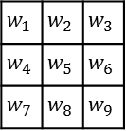
Convolutional network
5 | 0 | 3 | 3 | 7 | 9 | 3 | 5 | 2
7 | 6 | 8 | 8 | 1 | 6 | 7 | 7 | 8
5 | 9 | 8 | 9 | 4 | 3 | 0 | 3 | 5
2 | 3 | 8 | 1 | 3 | 3 | 3 | 7 | 0
9 | 9 | 0 | 4 | 7 | 3 | 2 | 7 | 2
0 | 4 | 5 | 5 | 6 | 8 | 4 | 1 | 4
8 | 1 | 1 | 7 | 9 | 9 | 3 | 6 | 7
0 | 3 | 5 | 9 | 4 | 4 | 6 | 4 | 4
4 | 4 | 8 | 4 | 3 | 7 | 5 | 5 | 0
$$w_{1}$$ | $$w_{2}$$ | $$w_{3}$$
$$w_{4}$$ | $$w_{5}$$ | $$w_{6}$$
$$w_{7}$$ | $$w_{8}$$ | $$w_{9}$$
$$∗$$
3 x 3
9 x 9

Slide 17




Convolutional network
5 | 0 | 3 | 3 | 7 | 9 | 3 | 5 | 2
7 | 6 | 8 | 8 | 1 | 6 | 7 | 7 | 8
5 | 9 | 8 | 9 | 4 | 3 | 0 | 3 | 5
2 | 3 | 8 | 1 | 3 | 3 | 3 | 7 | 0
9 | 9 | 0 | 4 | 7 | 3 | 2 | 7 | 2
0 | 4 | 5 | 5 | 6 | 8 | 4 | 1 | 4
8 | 1 | 1 | 7 | 9 | 9 | 3 | 6 | 7
0 | 3 | 5 | 9 | 4 | 4 | 6 | 4 | 4
4 | 4 | 8 | 4 | 3 | 7 | 5 | 5 | 0
$$w_{1}$$ | $$w_{2}$$ | $$w_{3}$$
$$w_{4}$$ | $$w_{5}$$ | $$w_{6}$$
$$w_{7}$$ | $$w_{8}$$ | $$w_{9}$$
$$∗$$
$$=$$
3 x 3
$$f×f$$
7 x 7
9 x 9
$$n −f+1$$
$$n×n$$
The image size becomes smaller and smaller
The pixels at the edges will contribute less.

Slide 18



Convolutional network
$$padding=1$$
 | 5 | 0 | 3 | 3 | 7 | 9 | 3 | 5 | 2
 | 7 | 6 | 8 | 8 | 1 | 6 | 7 | 7 | 8
 | 5 | 9 | 8 | 9 | 4 | 3 | 0 | 3 | 5
 | 2 | 3 | 8 | 1 | 3 | 3 | 3 | 7 | 0
 | 9 | 9 | 0 | 4 | 7 | 3 | 2 | 7 | 2
 | 0 | 4 | 5 | 5 | 6 | 8 | 4 | 1 | 4
 | 8 | 1 | 1 | 7 | 9 | 9 | 3 | 6 | 7
 | 0 | 3 | 5 | 9 | 4 | 4 | 6 | 4 | 4
 | 4 | 4 | 8 | 4 | 3 | 7 | 5 | 5 | 0
$$w_{1}$$ | $$w_{2}$$ | $$w_{3}$$
$$w_{4}$$ | $$w_{5}$$ | $$w_{6}$$
$$w_{7}$$ | $$w_{8}$$ | $$w_{9}$$
$$∗$$
$$=$$
3 x 3
$$f×f$$
7 x 7
$$n −f+1$$
9 x 9
11 x 11
$$n×n$$
$$(n+2p)×(n+2p)$$

Slide 19
Convolutional network
$$padding=1$$
0 | 0 | 0 | 0 | 0 | 0 | 0 | 0 | 0 | 0 | 0
0 | 5 | 0 | 3 | 3 | 7 | 9 | 3 | 5 | 2 | 0
0 | 7 | 6 | 8 | 8 | 1 | 6 | 7 | 7 | 8 | 0
0 | 5 | 9 | 8 | 9 | 4 | 3 | 0 | 3 | 5 | 0
0 | 2 | 3 | 8 | 1 | 3 | 3 | 3 | 7 | 0 | 0
0 | 9 | 9 | 0 | 4 | 7 | 3 | 2 | 7 | 2 | 0
0 | 0 | 4 | 5 | 5 | 6 | 8 | 4 | 1 | 4 | 0
0 | 8 | 1 | 1 | 7 | 9 | 9 | 3 | 6 | 7 | 0
0 | 0 | 3 | 5 | 9 | 4 | 4 | 6 | 4 | 4 | 0
0 | 4 | 4 | 8 | 4 | 3 | 7 | 5 | 5 | 0 | 0
0 | 0 | 0 | 0 | 0 | 0 | 0 | 0 | 0 | 0 | 0
$$w_{1}$$ | $$w_{2}$$ | $$w_{3}$$
$$w_{4}$$ | $$w_{5}$$ | $$w_{6}$$
$$w_{7}$$ | $$w_{8}$$ | $$w_{9}$$
$$∗$$
$$=$$
3 x 3
$$f×f$$
7 x 7
$$n −f+1$$
11 x 11
$$(n+2p)×(n+2p)$$

Slide 20


Convolutional network
$$padding=1$$
$$stride=1$$
0 | 0 | 0 | 0 | 0 | 0 | 0 | 0 | 0 | 0 | 0
0 | 5 | 0 | 3 | 3 | 7 | 9 | 3 | 5 | 2 | 0
0 | 7 | 6 | 8 | 8 | 1 | 6 | 7 | 7 | 8 | 0
0 | 5 | 9 | 8 | 9 | 4 | 3 | 0 | 3 | 5 | 0
0 | 2 | 3 | 8 | 1 | 3 | 3 | 3 | 7 | 0 | 0
0 | 9 | 9 | 0 | 4 | 7 | 3 | 2 | 7 | 2 | 0
0 | 0 | 4 | 5 | 5 | 6 | 8 | 4 | 1 | 4 | 0
0 | 8 | 1 | 1 | 7 | 9 | 9 | 3 | 6 | 7 | 0
0 | 0 | 3 | 5 | 9 | 4 | 4 | 6 | 4 | 4 | 0
0 | 4 | 4 | 8 | 4 | 3 | 7 | 5 | 5 | 0 | 0
0 | 0 | 0 | 0 | 0 | 0 | 0 | 0 | 0 | 0 | 0
$$w_{1}$$ | $$w_{2}$$ | $$w_{3}$$
$$w_{4}$$ | $$w_{5}$$ | $$w_{6}$$
$$w_{7}$$ | $$w_{8}$$ | $$w_{9}$$
$$∗$$
$$=$$
3 x 3
$$f×f$$
9 x 9
$$n −f+2p+1$$
11 x 11
$$(n+2p)×(n+2p)$$
Valid: no padding
Same: padding, the output has the same size as the input

Slide 21


Convolutional network
$$padding=1$$
$$stride=2$$
0 | 0 | 0 | 0 | 0 | 0 | 0 | 0 | 0 | 0 | 0
0 | 5 | 0 | 3 | 3 | 7 | 9 | 3 | 5 | 2 | 0
0 | 7 | 6 | 8 | 8 | 1 | 6 | 7 | 7 | 8 | 0
0 | 5 | 9 | 8 | 9 | 4 | 3 | 0 | 3 | 5 | 0
0 | 2 | 3 | 8 | 1 | 3 | 3 | 3 | 7 | 0 | 0
0 | 9 | 9 | 0 | 4 | 7 | 3 | 2 | 7 | 2 | 0
0 | 0 | 4 | 5 | 5 | 6 | 8 | 4 | 1 | 4 | 0
0 | 8 | 1 | 1 | 7 | 9 | 9 | 3 | 6 | 7 | 0
0 | 0 | 3 | 5 | 9 | 4 | 4 | 6 | 4 | 4 | 0
0 | 4 | 4 | 8 | 4 | 3 | 7 | 5 | 5 | 0 | 0
0 | 0 | 0 | 0 | 0 | 0 | 0 | 0 | 0 | 0 | 0
$$w_{1}$$ | $$w_{2}$$ | $$w_{3}$$
$$w_{4}$$ | $$w_{5}$$ | $$w_{6}$$
$$w_{7}$$ | $$w_{8}$$ | $$w_{9}$$
$$∗$$
$$=$$
3 x 3
$$f×f$$
9 x 9
5 x 5
$$\frac{n−f+2p}{s}+1$$
$$n −f+2p+1$$
11 x 11
$$(n+2p)×(n+2p)$$

Slide 22
Convolutional network
32 x 32 x 3
1 number
75 dimensional
dot product
W
H
C
5x5x3
filter
32
(H)
32 (W)
3(C)
Convolve the filter with the image
-- slide over the image spatially
-- at each point calculate the dot products

Slide 23
Convolutional network
28 x 28
x 1
32 x 32 x 3
W
H
C
W
H
C
5x5x3
filter
28
(H)
32
(H)
28 (W)
32 (W)
3(C)
Convolve the filter with the image
-- slide over the image spatially
-- at each point calculate the dot products

Slide 24
Convolutional network
x 1
x 2
x 4
32 x 32 x 3
28 x 28
x 3
W
H
C
W
H
C
5x5x3
filter
28
(H)
32
(H)
28 (W)
32 (W)
3(C)
Convolve the filter with the image
-- slide over the image spatially
-- at each point calculate the dot products

Slide 25
Convolutional network
28 x 28
x 4
32 x 32 x 3
W
H
C
W
H
C
5x5x3
filter
28
(H)
32
(H)
28 (W)
32 (W)
3(C)
Followed by RELU (rectified linear unit)

Slide 26
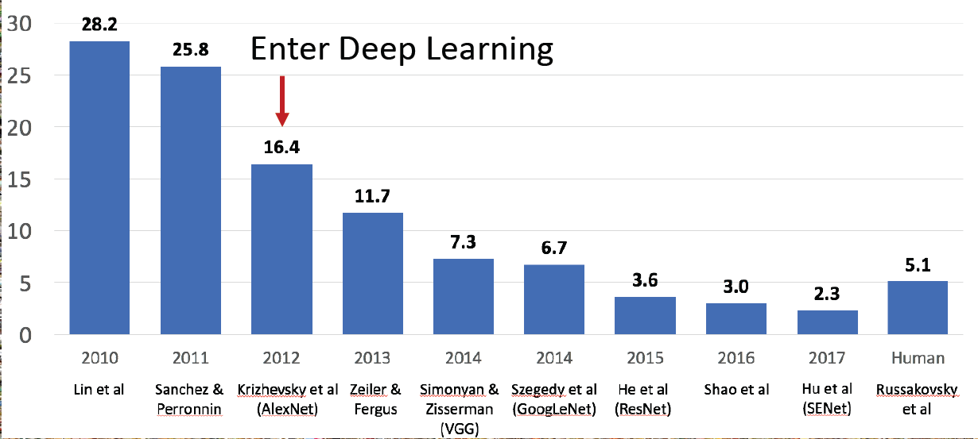
Example (AlexNet)
1999
Digit recognition
by USPS
2008
GPU revolution
2009
ImageNet
Launched
1989,
1998
LeNet
2012
AlexNet wins
in ImageNet

Slide 27
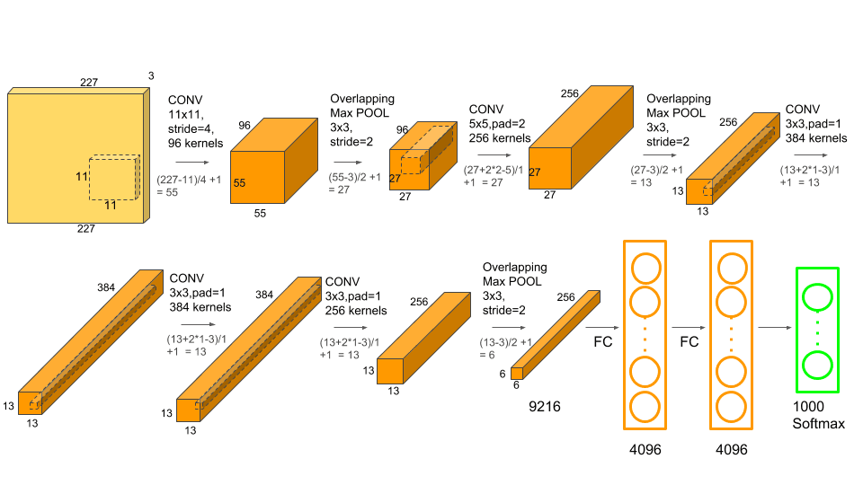
Example (AlexNet)

Slide 28
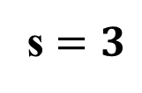

Max Pooling
6 | 0 | 5 | 0 | 4 | 2 | 0 | 0 | 0
15 | 2 | 5 | 0 | 0 | 0 | 0 | 5 | 0
18 | 10 | 0 | 0 | 0 | 2 | 5 | 3 | 0
21 | 0 | 0 | 0 | 0 | 0 | 8 | 2 | 0
16 | 2 | 0 | 3 | 4 | 0 | 1 | 0 | 0
14 | 0 | 2 | 16 | 4 | 0 | 0 | 4 | 0
8 | 3 | 13 | 8 | 0 | 0 | 0 | 2 | 0
8 | 2 | 12 | 2 | 0 | 0 | 0 | 0 | 0
7 | 9 | 6 | 0 | 0 | 4 | 0 | 0 | 0
$$f=3$$
s $=3$
9 x 9

Slide 29

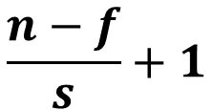
Max Pooling
6 | 0 | 5 | 0 | 4 | 2 | 0 | 0 | 0
15 | 2 | 5 | 0 | 0 | 0 | 0 | 5 | 0
18 | 10 | 0 | 0 | 0 | 2 | 5 | 3 | 0
21 | 0 | 0 | 0 | 0 | 0 | 8 | 2 | 0
16 | 2 | 0 | 3 | 4 | 0 | 1 | 0 | 0
14 | 0 | 2 | 16 | 4 | 0 | 0 | 4 | 0
8 | 3 | 13 | 8 | 0 | 0 | 0 | 2 | 0
8 | 2 | 12 | 2 | 0 | 0 | 0 | 0 | 0
7 | 9 | 6 | 0 | 0 | 4 | 0 | 0 | 0
$$f=3$$
18
4
5
21
16
4
s $=3$
13
8
2
3 x 3
9 x 9
$$\frac{n−f}{s}+1$$
$$n×n$$

Slide 30
Example (AlexNet)

Slide 31
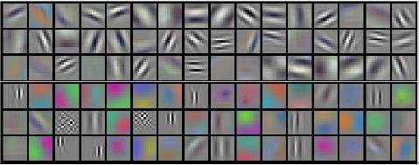
Example (AlexNet)

